Slide 1


Tech ABC Corp - HR Database
[Maleina Bidek, August 19, 2023]

Slide 2
Business Scenario
Business request
Tech ABC Corp saw explosive growth with a sudden appearance onto the gaming scene with their new AI-powered video game console. As a result, they have gone from a small 10 person operation to 200 employees and 5 locations in under a year. HR is having trouble keeping up with the growth, since they are still maintaining employee information in a spreadsheet. While that worked for ten employees, it has becoming increasingly cumbersome to manage as the company expands.
As such, the HR department has requested the design and creation of a database capable of managing their employee information.
Dataset
The HR dataset is currently held in an Excel workbook which consists of 206 records, with eleven columns. The data is in human readable format, and has not been normalized at all. The data lists the names of employees at Tech ABC Corp as well as information such as job title, department, manager's name, hire date, start date, end date, work location, and salary.
IT Department Best Practices
The IT Department has certain Best Practices policies for databases one should follow, as detailed in the Best Practices document.

Slide 3
Step 1
Data Architecture Foundations – Business and Technical Requirements

Slide 4
Data Architect Business Requirements
Purpose of the new database:
The business partner is requesting the creation of a new database to replace the spreadsheet that it currently uses to collect HR information about its employees. Now that more than one person will be maintaining the data, they want to make sure it is easier to manage, as well as better ensure its integrity and security.
Current data management solution:
The business partner currently uses a shared Excel workbook with 11 columns and 206 rows.
Data that is currently available:
HR information such as employee names, job title, department, manager’s name, hire date, start date, end date, work location and salary.
Additional data requests:
In the future they will likely need the database to connect with the payroll system since that system maintains employee attendance and paid time off.
Who will own/manage data
The HR department will own / manage the data in the database.

Slide 5
Data Architecture Business Requirements, cont.
Who will have access to database
Any employee with a domain login will have read only access to the database, however they will not have access to salary information. Management and HR personnel will have read and write permissions and access to salary information.
Estimated size of database
The spreadsheet currently contains 206 rows. It should be safe to assume this as a minimum for the initial database, which will continue to grow.
Estimated annual growth
The business projects 20% growth per year for the next 5 years. We should be able to assume that data would grow at about the same rate.
Is any of the data sensitive/restricted
As mentioned above, only management and HR personnel should have access to salary information.

Slide 6
Data Architecture Technical Requirements
Justification for the new database
Easier to manage the data
Ensure data integrity
Implement security for sensitive information
Database objects
The following core tables will be created: Employee, Employee Role, Employee Manager, Employee Location, Employee Address, Salary. Additional lookup tables will include Job Title, Department, Office Location, Education Level, City and State.
Data ingestion
Because the data is currently held in an Excel spreadsheet, the recommended ingestion method is Extract, Transform, Load (ETL). The spreadsheet contents will be imported into staging tables. Then individual data can be transformed as necessary before loading it into the final tables.
Data governance (Ownership and User access)
Ownership: The HR department will own and manage the data in the database.
User Access: Employees with a domain login will have read only access to the database, however they will not have access to salary information. Management and HR personnel will have read and write permissions and access to salary information.

Slide 7
Data Architecture Technical Requirements, cont.
Scalability
Because there are currently only 206 rows in the non-normalized dataset, the projected size of the database is relatively small. The number of total users, currently around 200, is also relatively small. The vast majority of these users would only be using the database to occasionally query information and not using the data for their daily tasks. A small percentage of users (approximately 10%) will actually be writing information to the database. Even considering an average growth of 20 percent, none of these factors seems to justify the overhead of replication or sharding at this time.
Flexibility
In the future the database will likely need to connect with the payroll system since that system maintains employee attendance and paid time off. Any design will need to take this into consideration.
Storage & retention
Storage (disk or in-memory): The database should be allotted a standard partition of 1GB since we do not anticipate exceeding 10K rows in the next year. Because the data will not be used for higher computations it can be stored on disk.
Retention: It is required by law to retain employee data for at least 7 years.
Backup
HR data is business critical data and as such there should be a full backup 1 time per week and an incremental backup daily.

Slide 8
Step 2
Relational Database Design

Slide 9
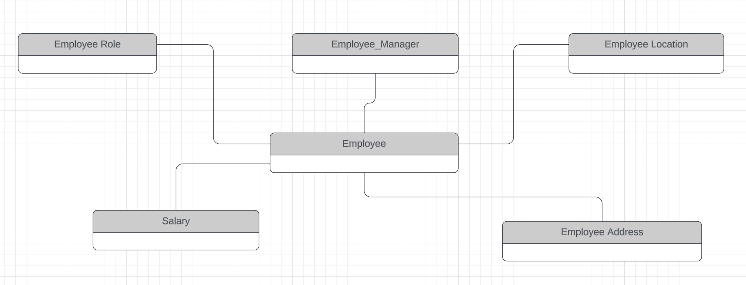
Conceptual ERD
Notes:
We should track roles, managers and locations separately any of these could change over time without necessitating a change in the other.
Salary information should be kept separate since access to it will be restricted.

Slide 10
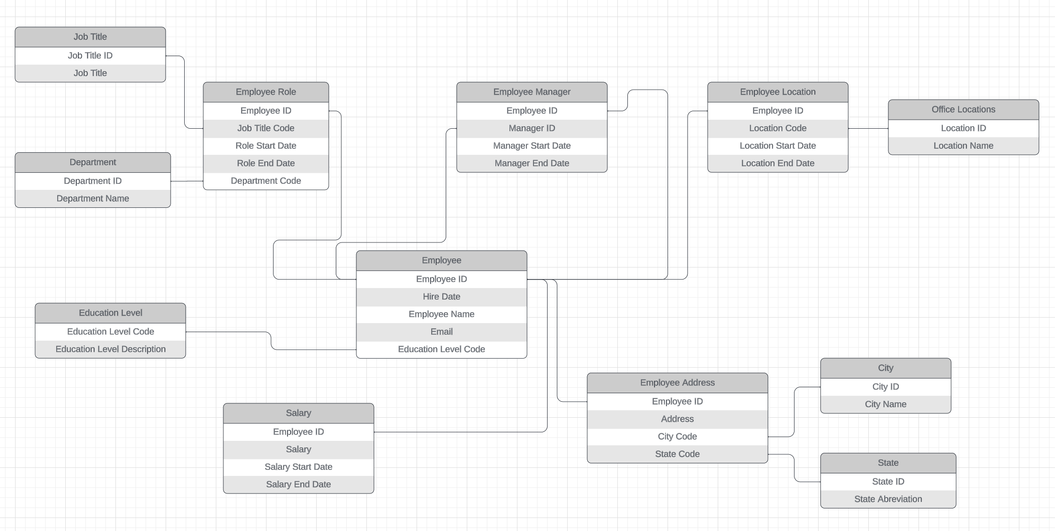
Logical ERD
Notes:
Look up tables have been created for Job Title, Department, Education Level, Office Location, City and State to comply with 3rd normal form.
Employee Role, Employee Manager, Employee Location and Salary each have a set of start and end dates associated with them. These can be initialized with the same start and end date fields that exist in the current Excel dataset. Post-implementation they can be tracked separately.
Employee Address does not have start and end dates since it is not a business necessity to track address history.
Likewise, we assume that employee name, email and education level histories are not necessary to track separately.

Slide 11
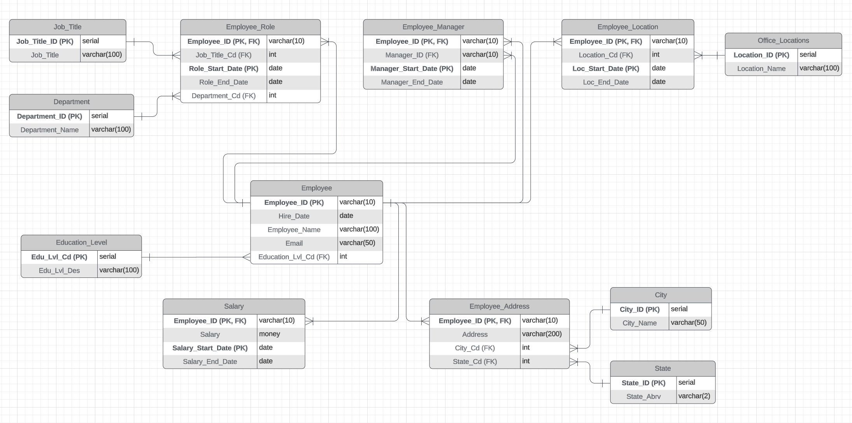
Physical ERD
Notes:
The Employee_ID is the only primary key on the Employee table. This is necessary for the foreign key constraints for the other related tables. If an employee quits and subsequently rejoins the company, they will require another unique id.
I kept the alphanumeric format for the Employee_ID and ensured that the old ids were used. It will be helpful if develop a function to automate the generation of these ids.
The start dates and Employee_ID form a compound key on the Employee_Role, Employee_Manager, Employee_Location and Salary tables.
Ideally, we should split fields like Name into First_Name and Last_Name. This would require developing a function to parse names and as such, is out of scope for this project. This could be a subsequent modification.

Slide 12
Step 3
Create A Physical Database

Slide 13
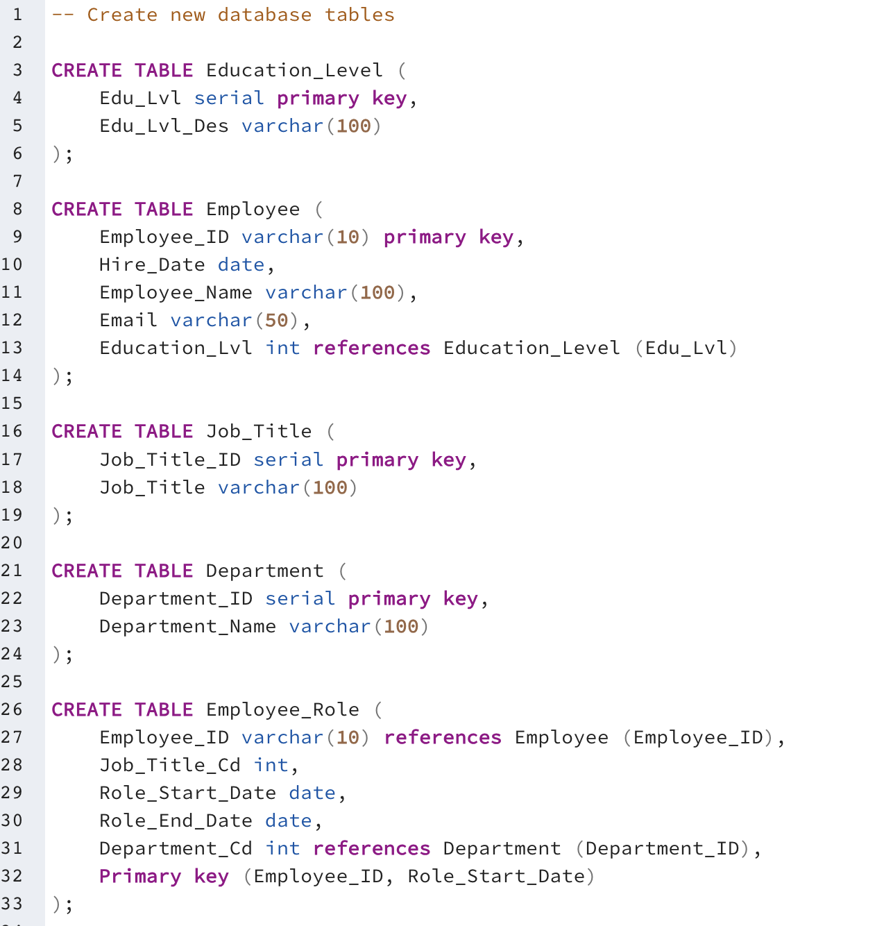
DDL
Create the new database tables:

Slide 14
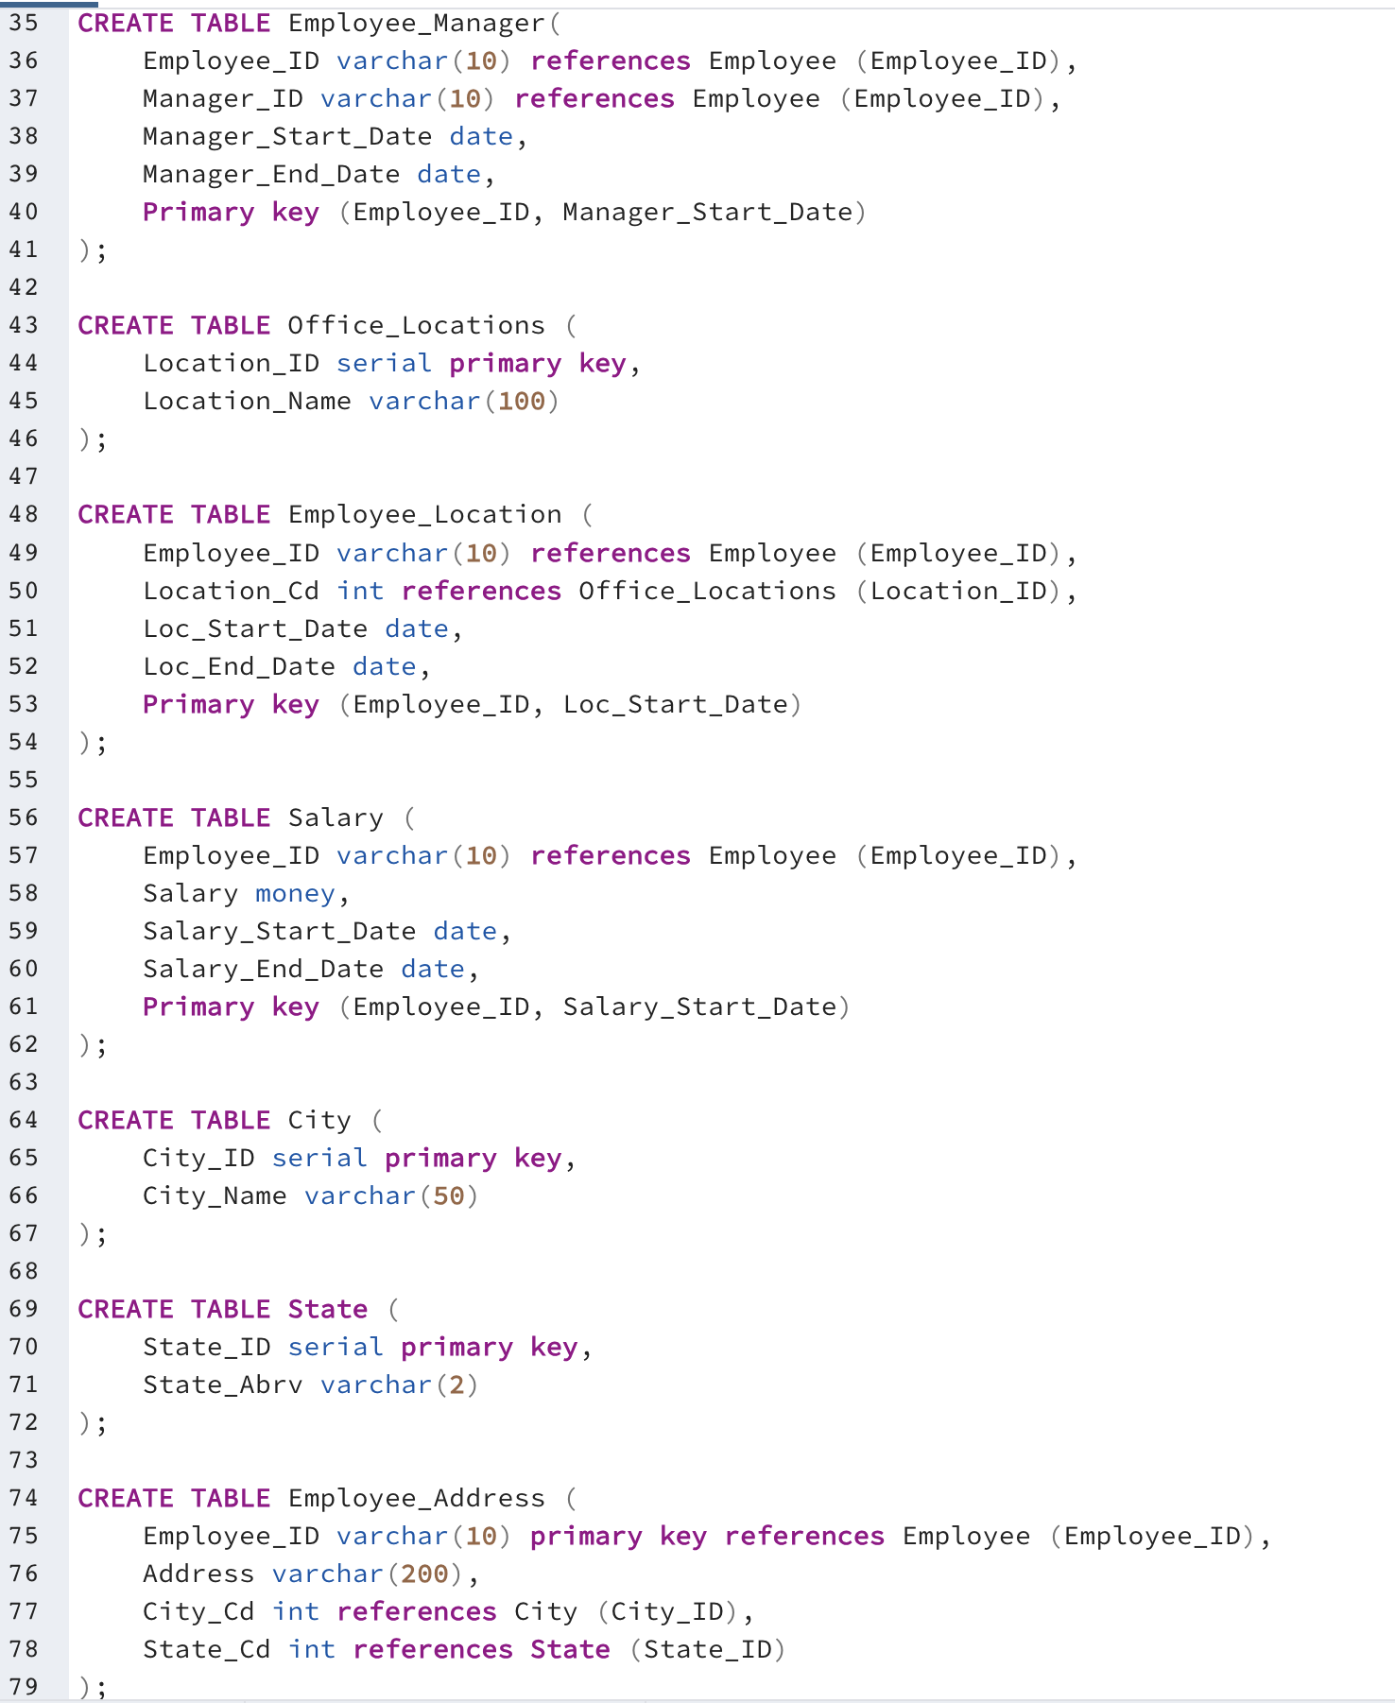
DDL
Create the new database tables, cont.:

Slide 15
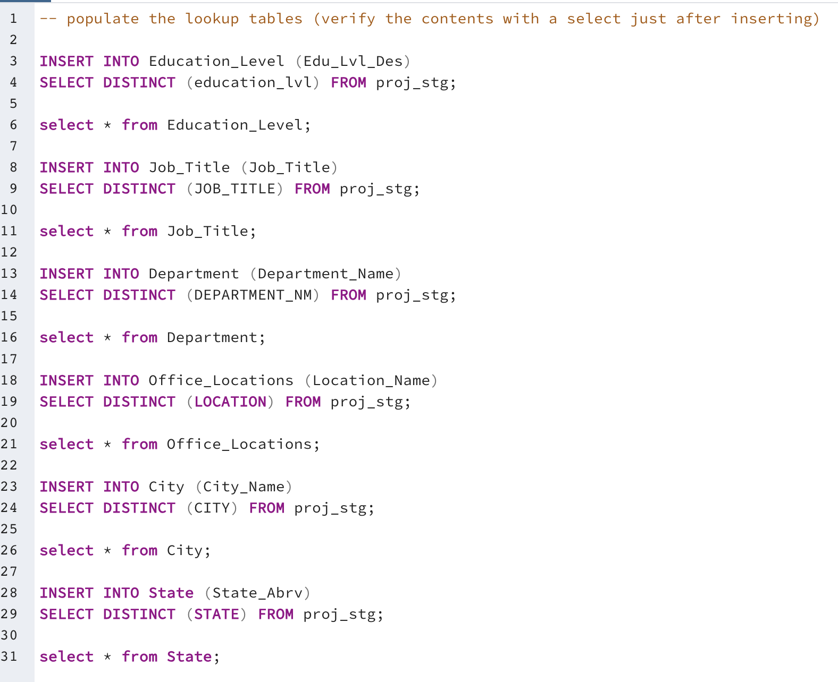
CRUD
Insert data into the lookup tables first and verify:

Slide 16
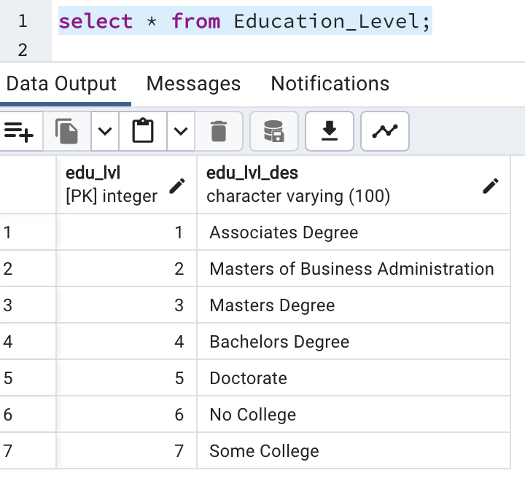
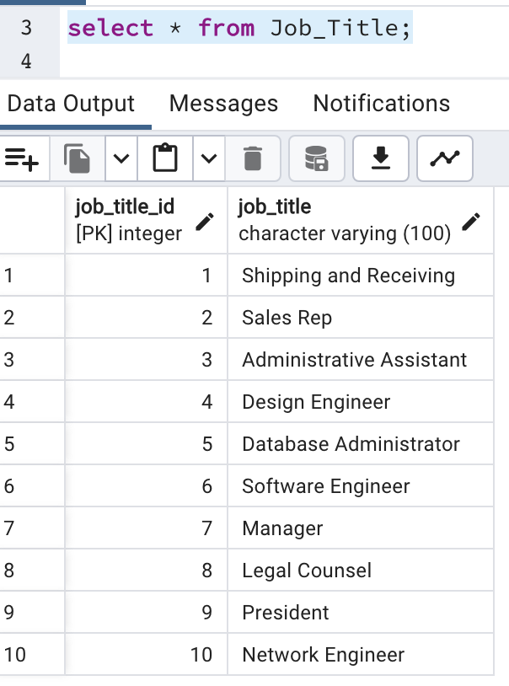
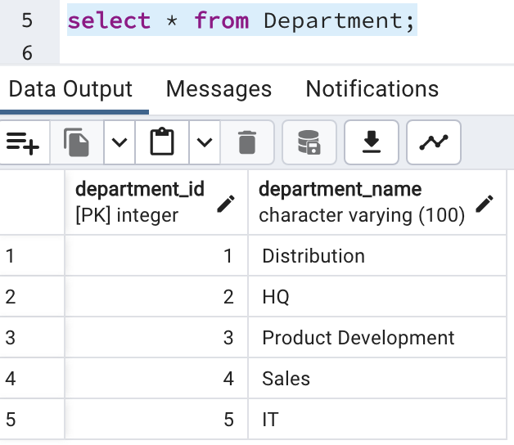
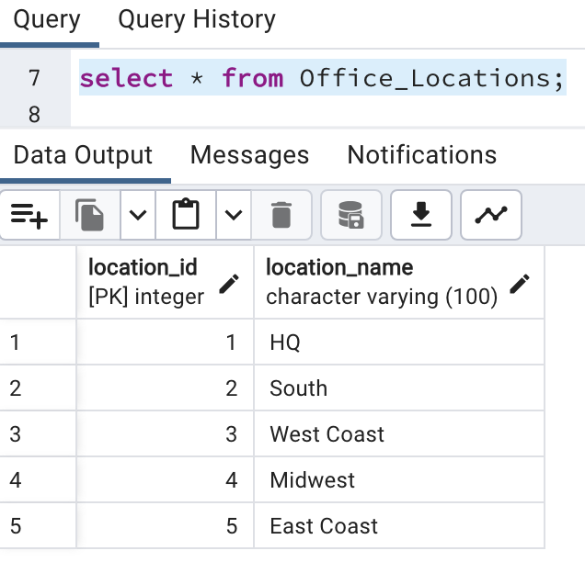
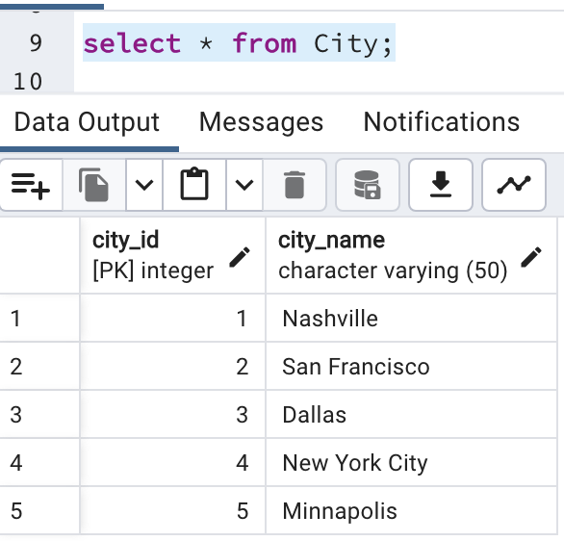
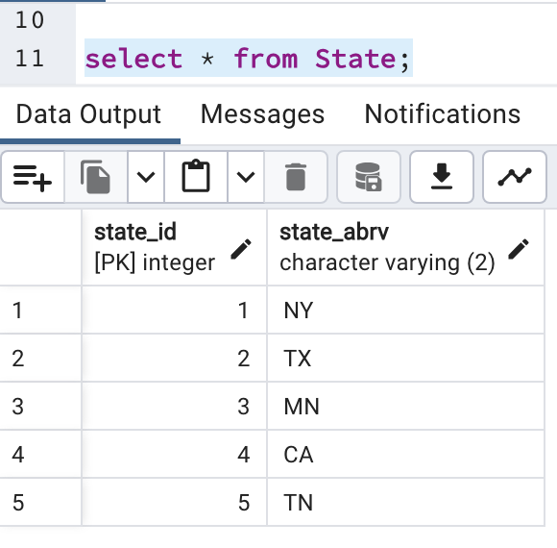
CRUD
Results of the select statements for the lookup tables:

Slide 17
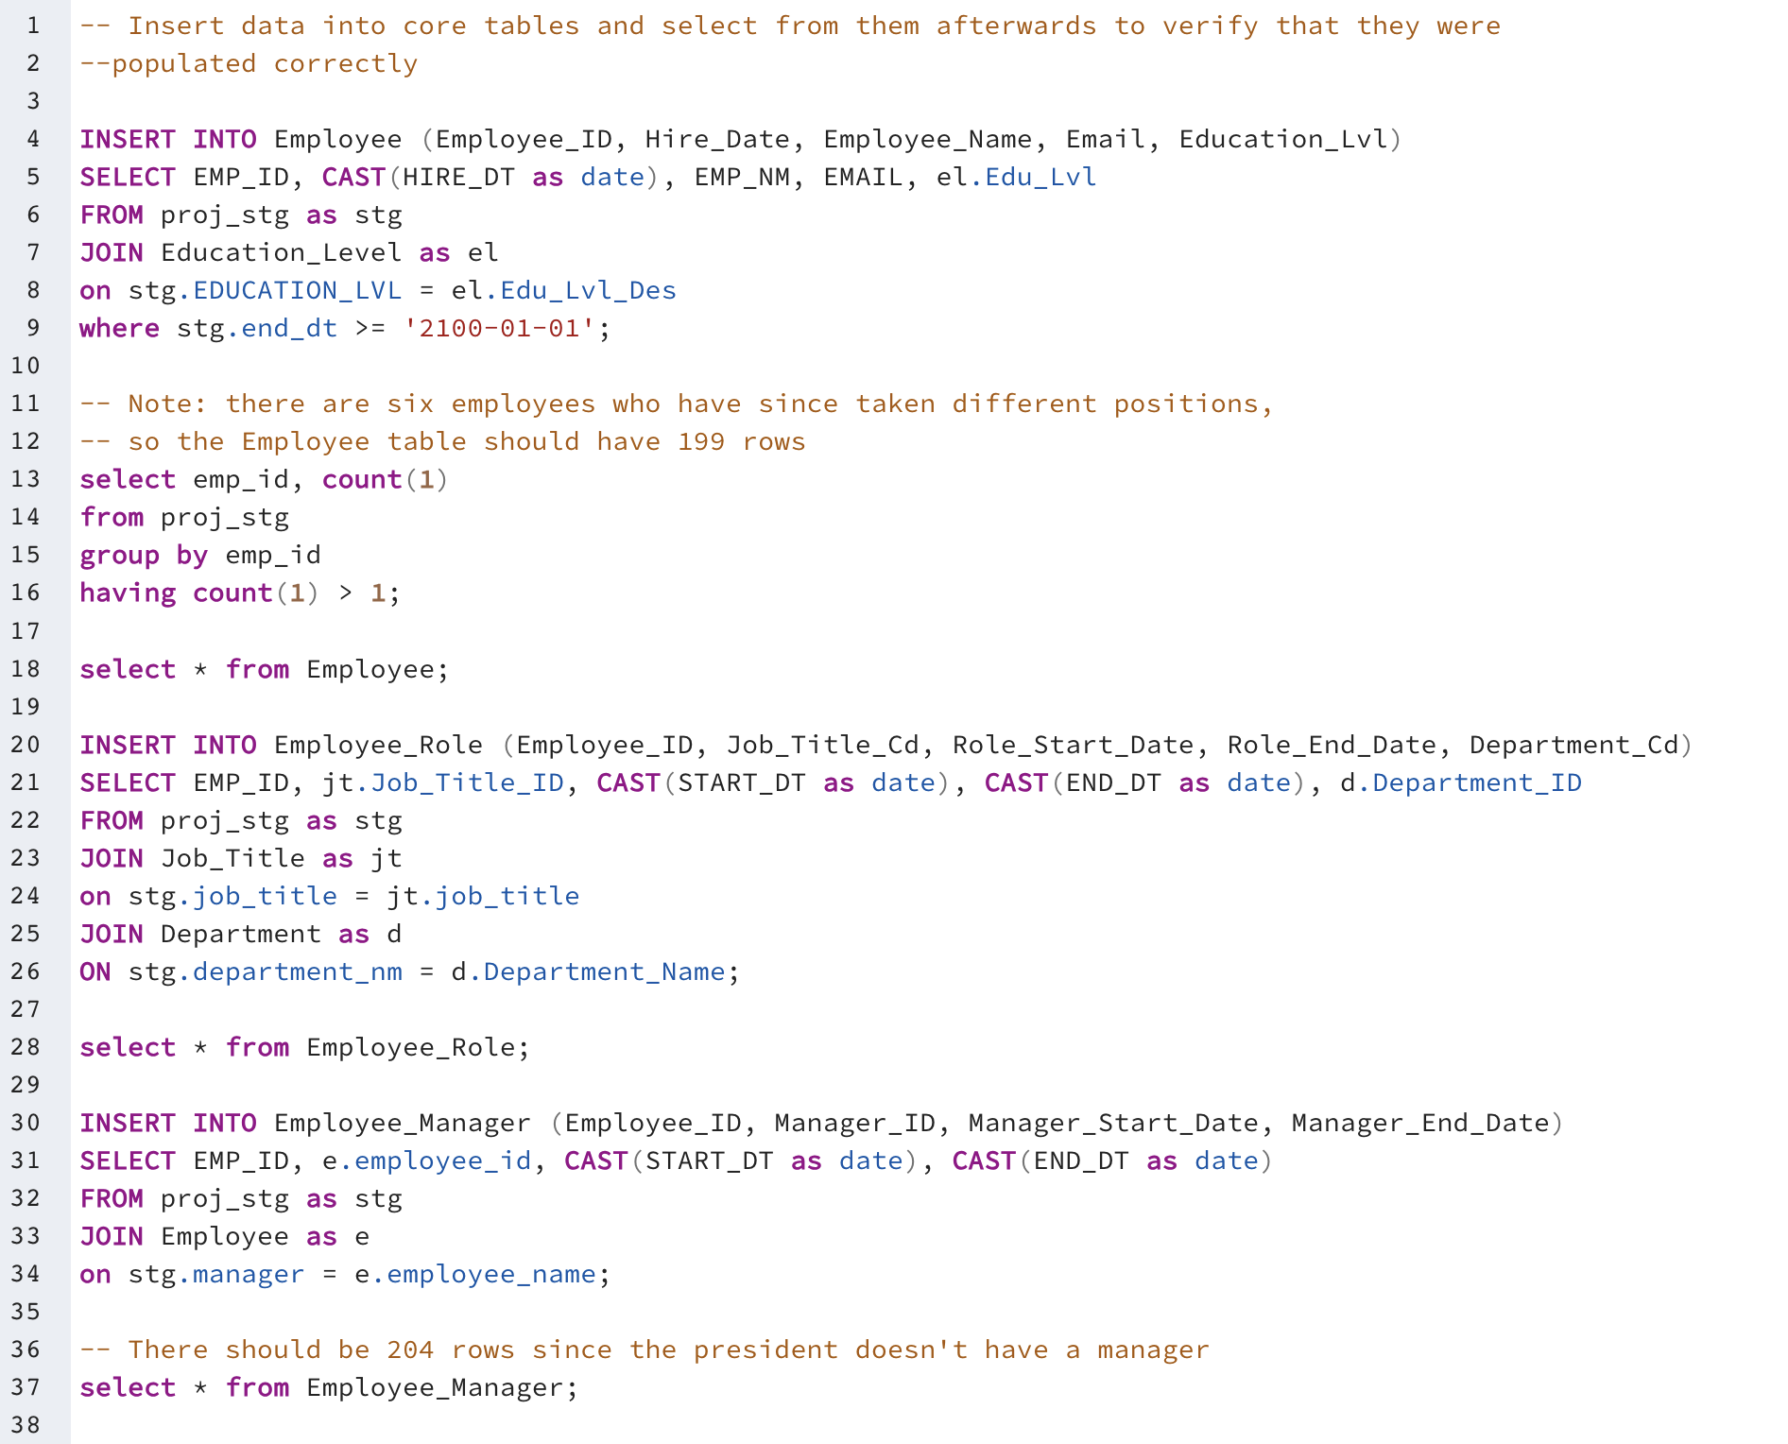
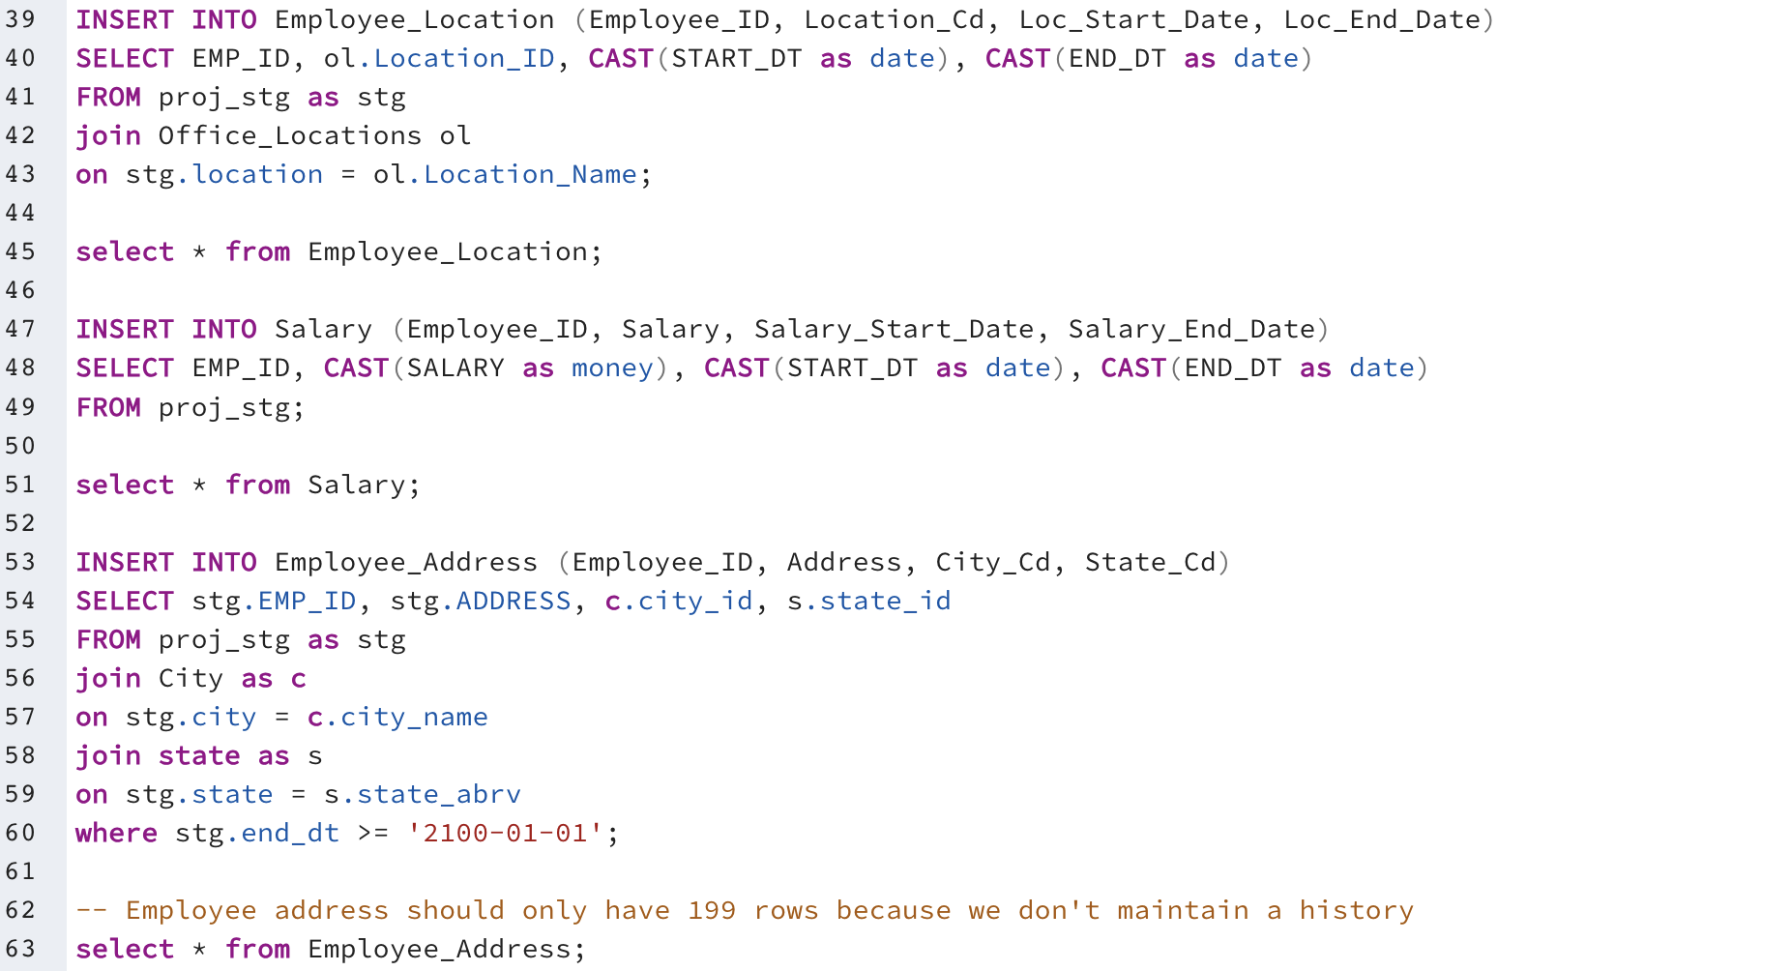
CRUD
Insert data into the core tables and verify:

Slide 18
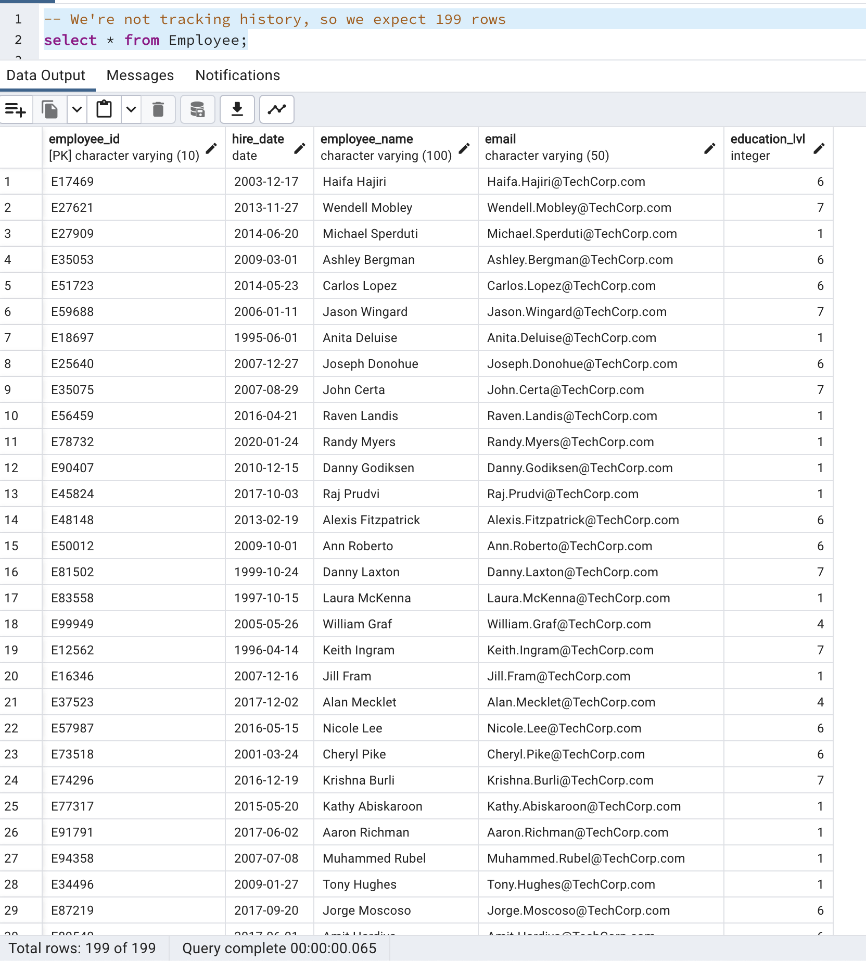
CRUD
Results of the select statements for the core tables - Employee:

Slide 19
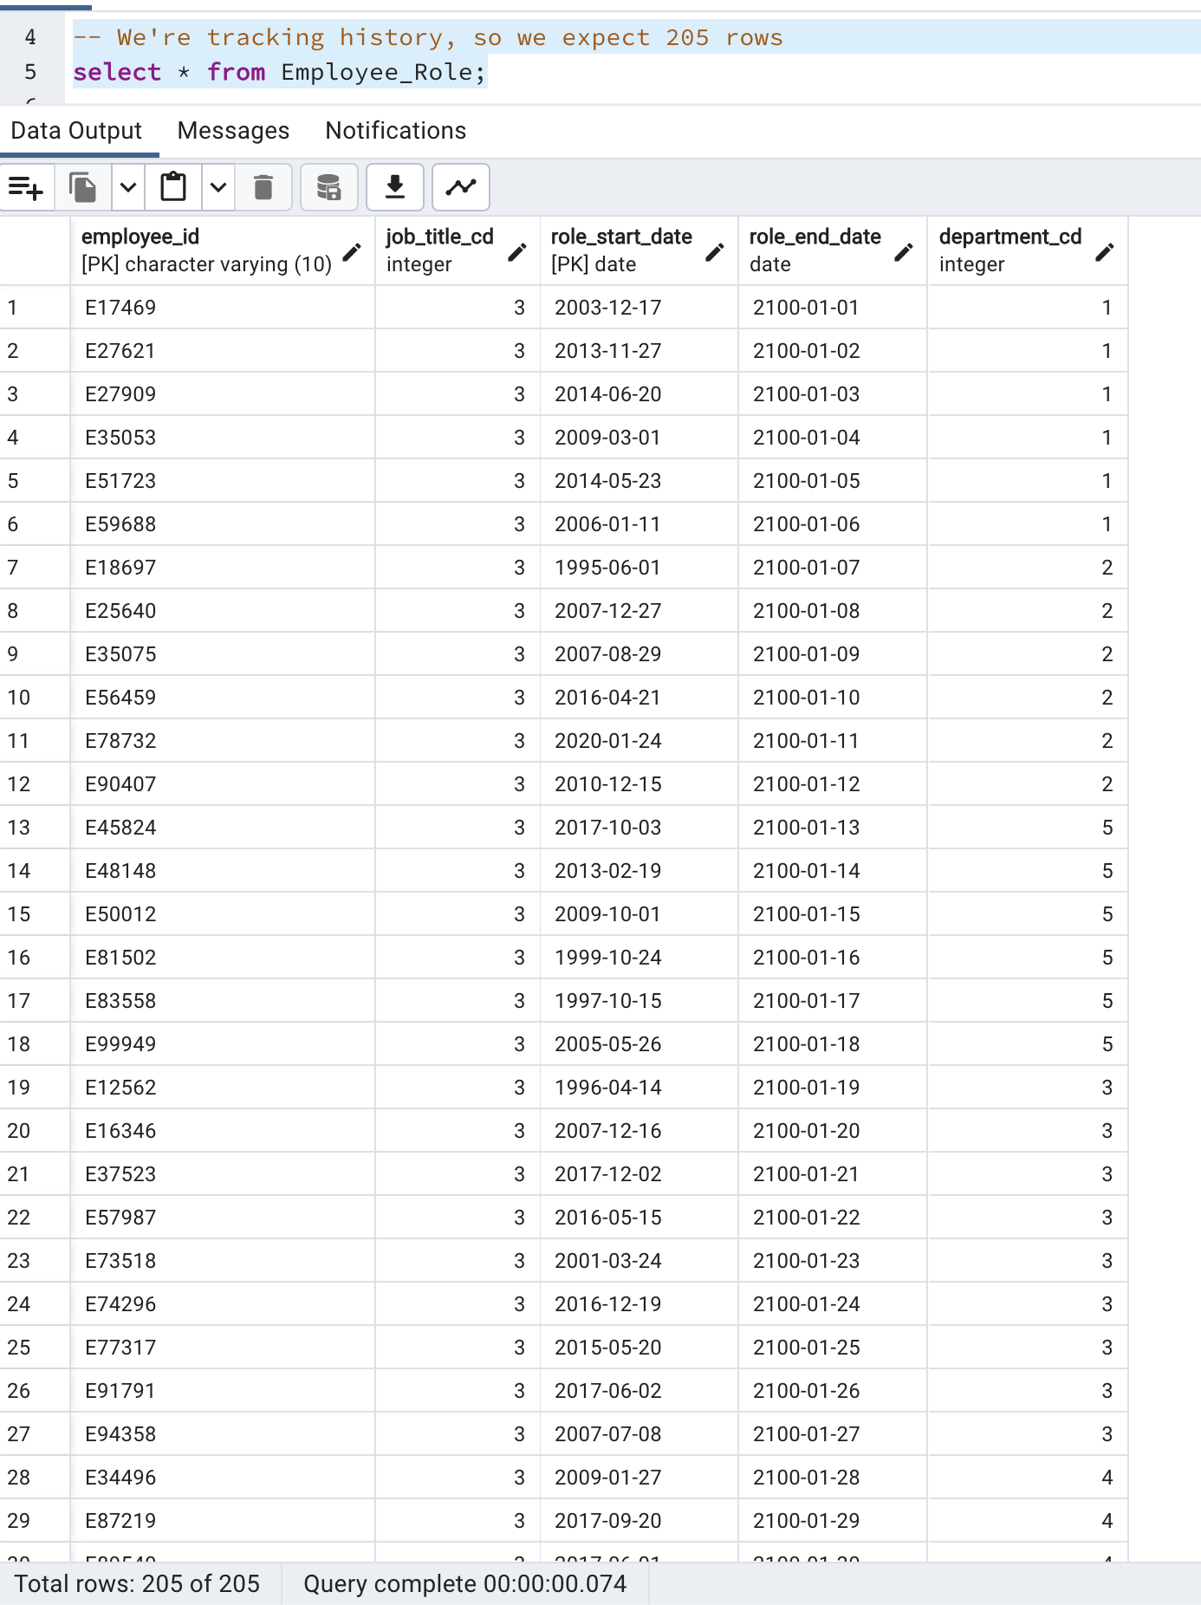
CRUD
Results of the select statements for the core tables – Employee_Role:

Slide 20
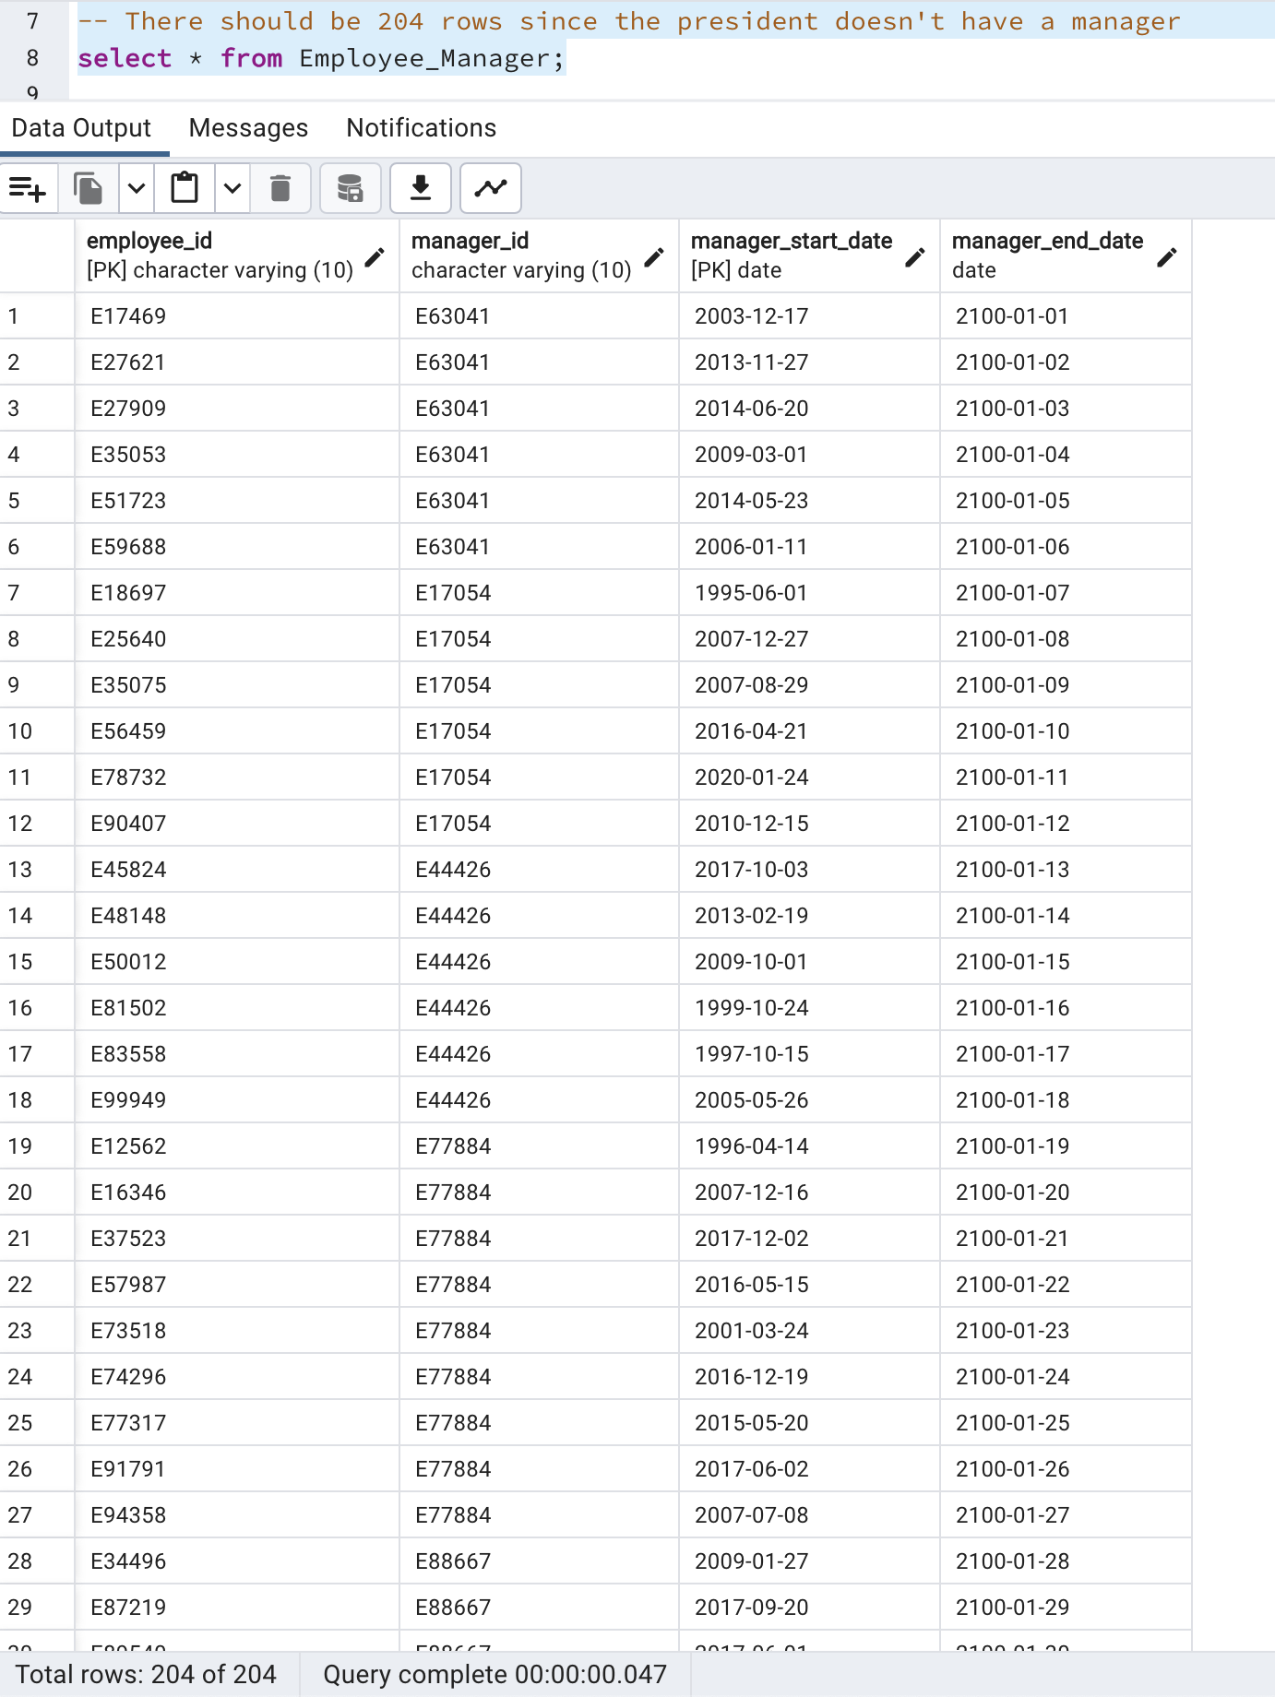
CRUD
Results of the select statements for the core tables – Employee_Manager:

Slide 21
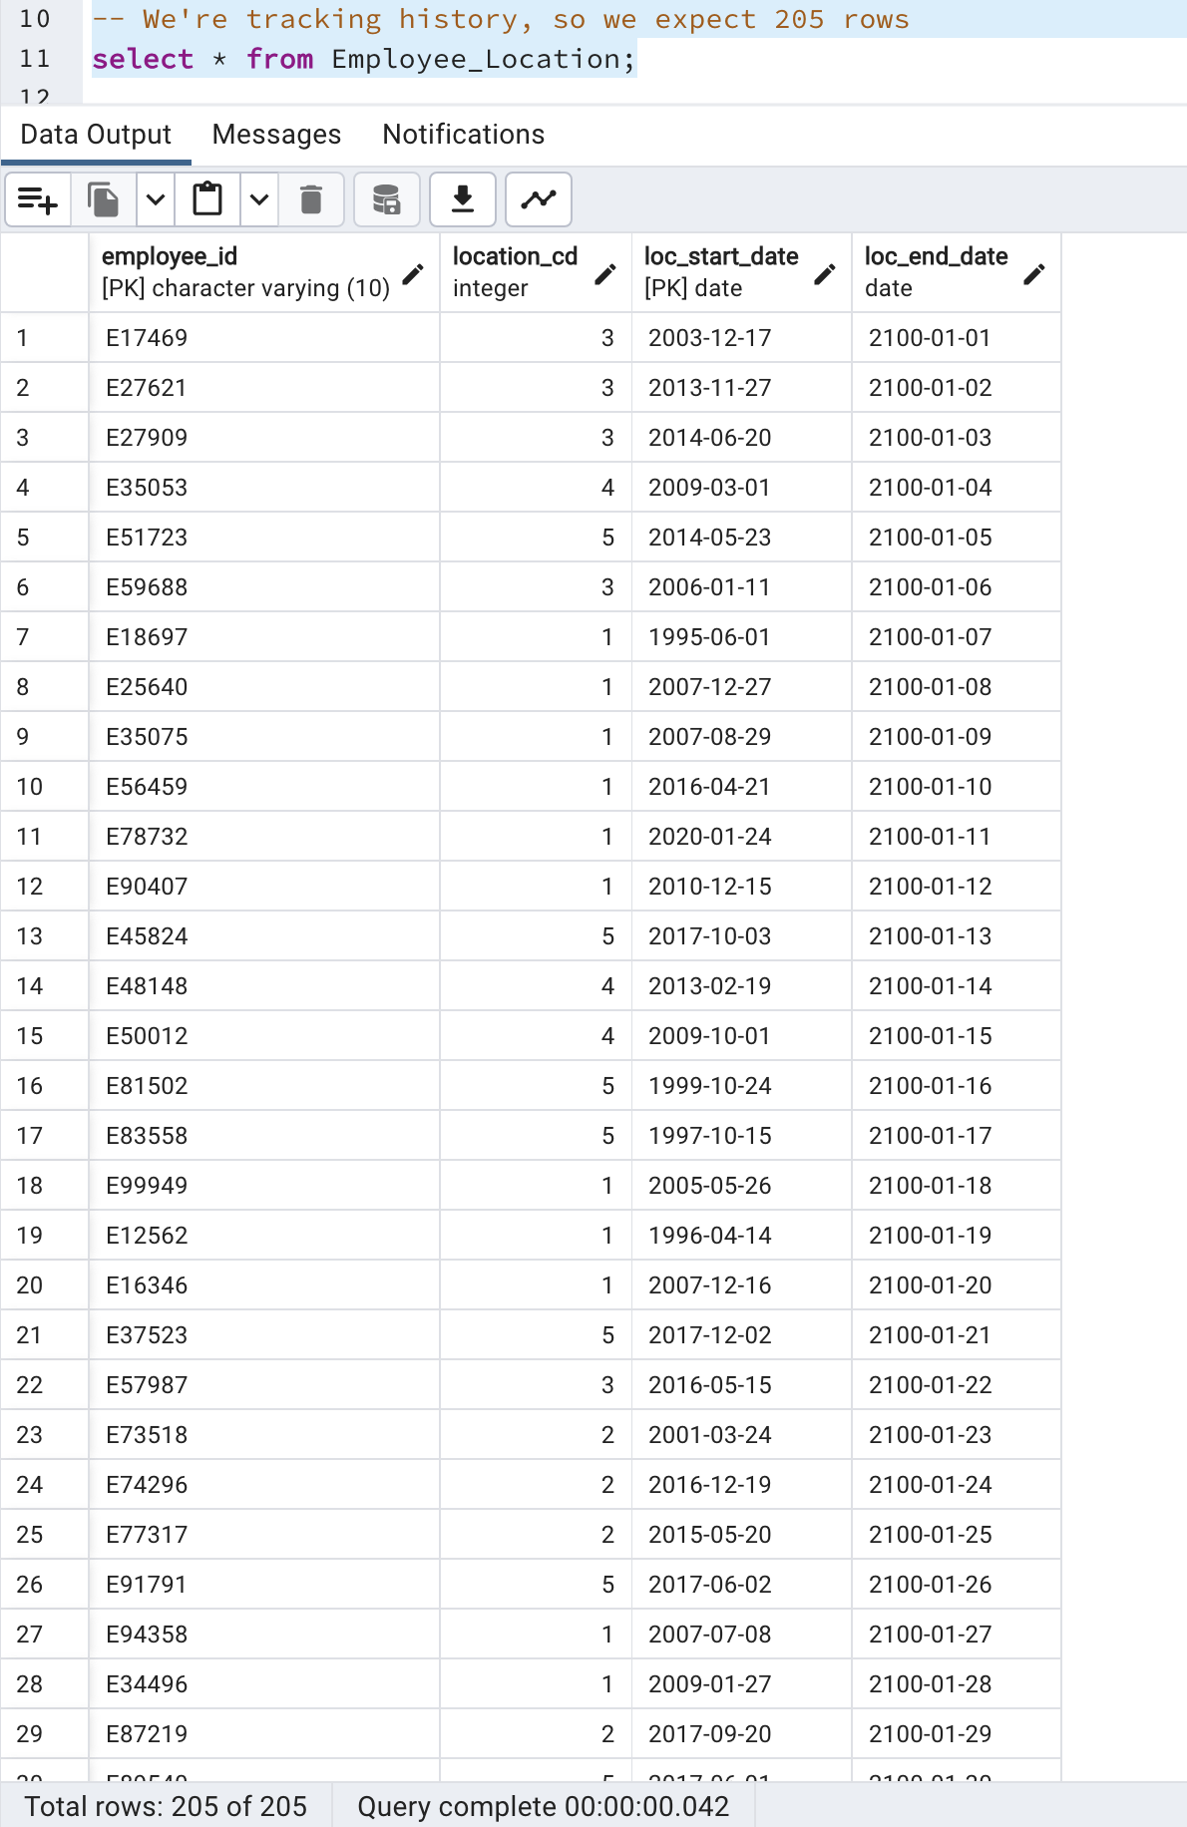
CRUD
Results of the select statements for the core tables – Employee_Location:

Slide 22
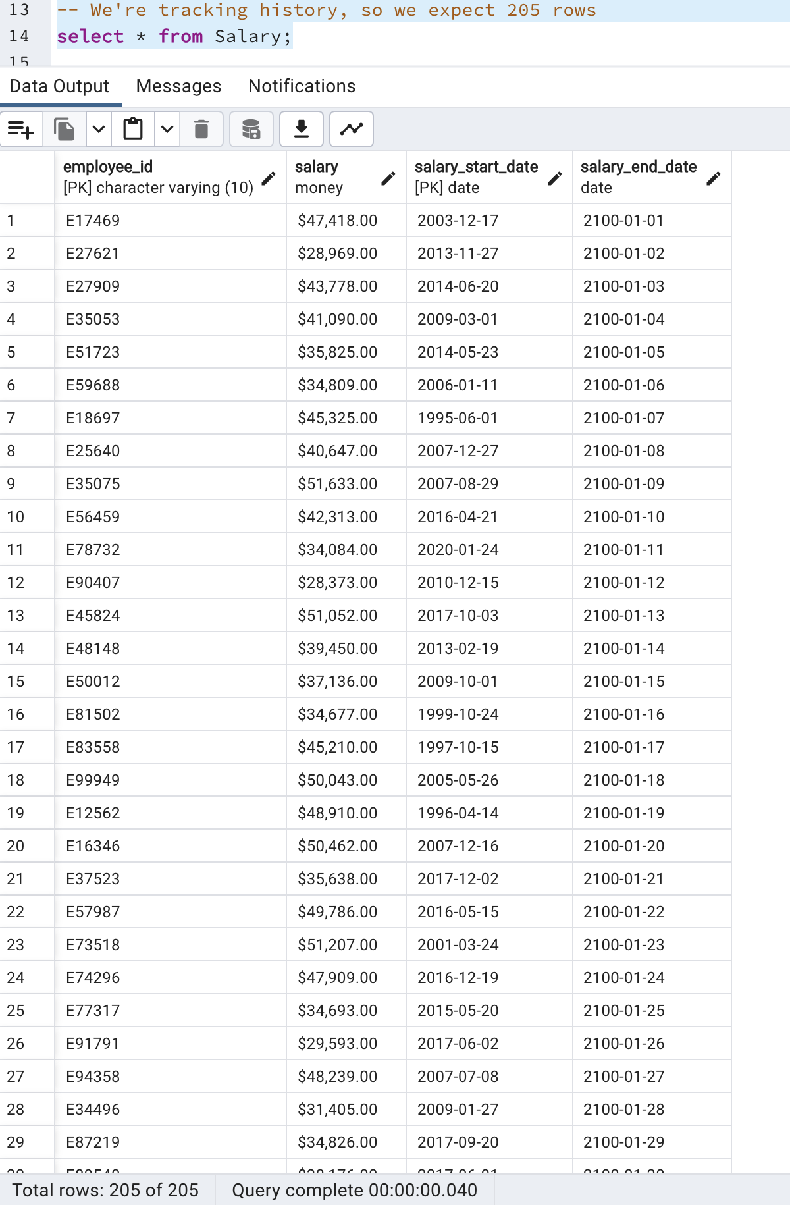
CRUD
Results of the select statements for the core tables - Salary:

Slide 23
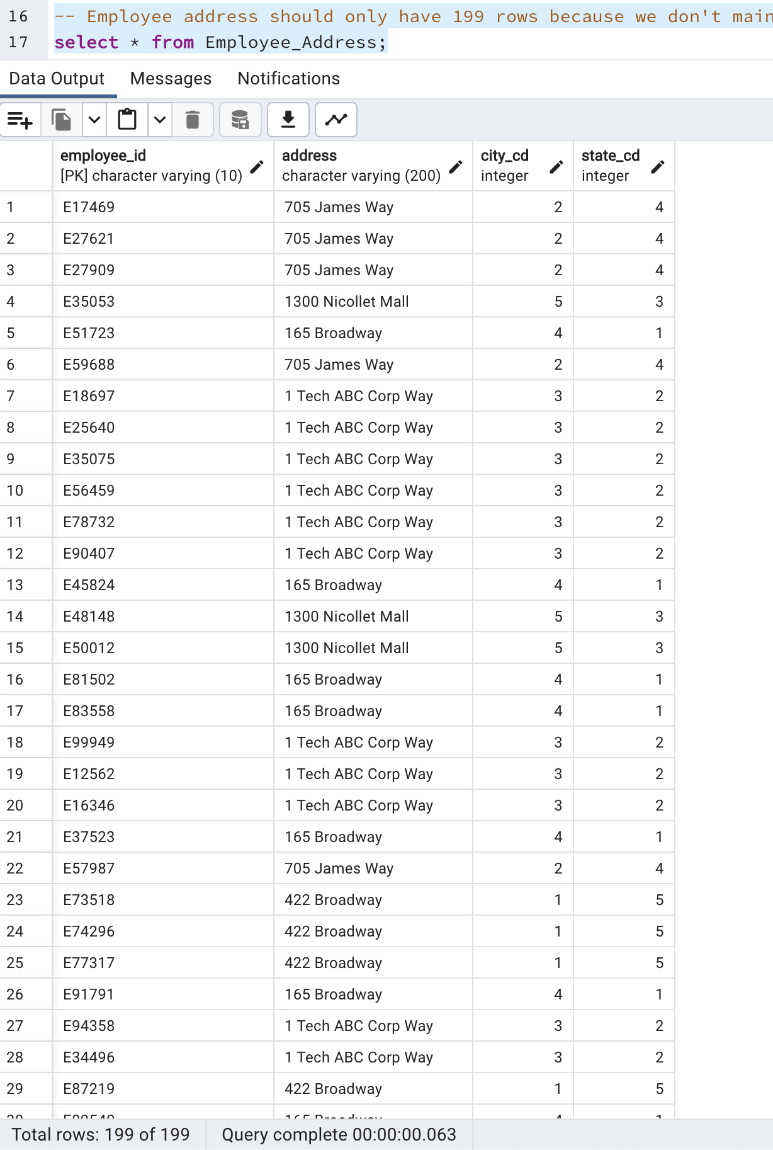
CRUD
Results of the select statements for the core tables – Employee_Address:

Slide 24
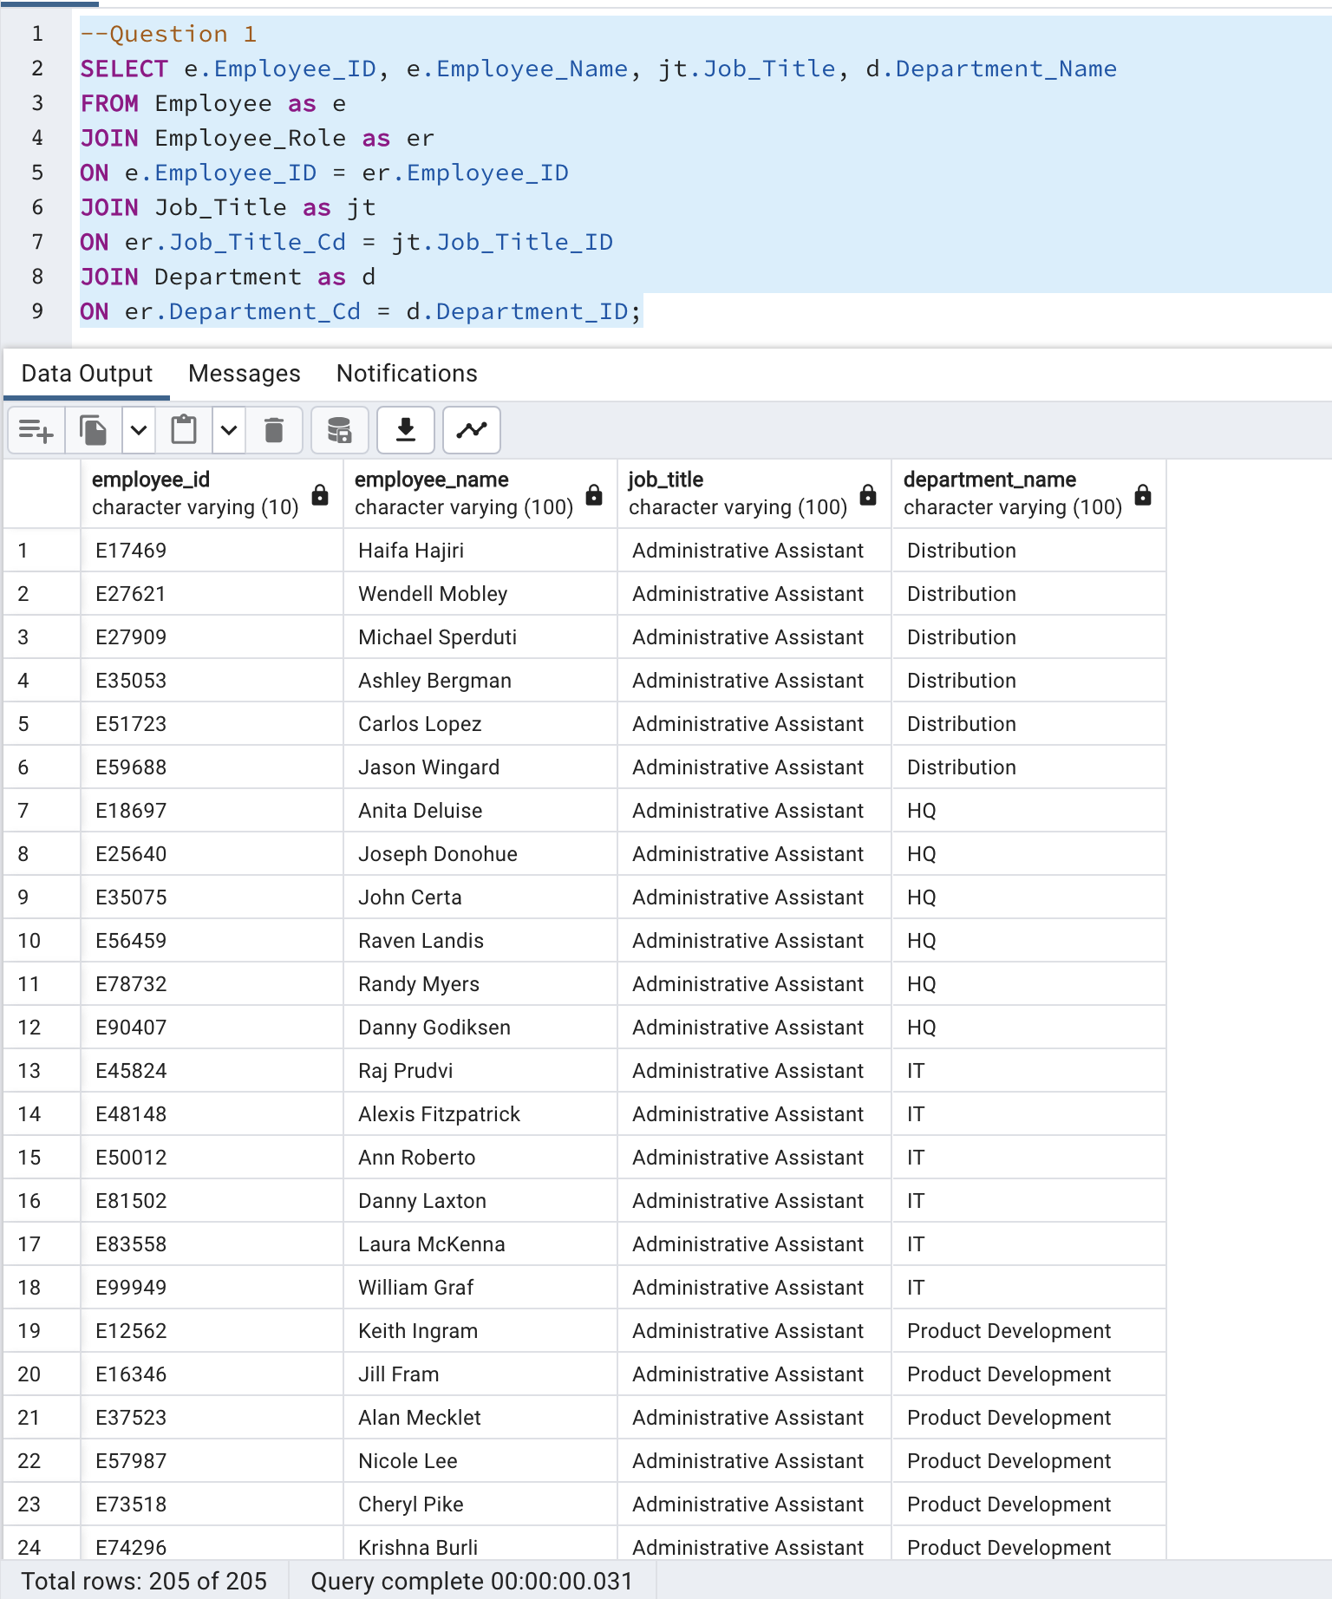
CRUD
Question 1: Return a list of employees with Job Titles and Department Names

Slide 25
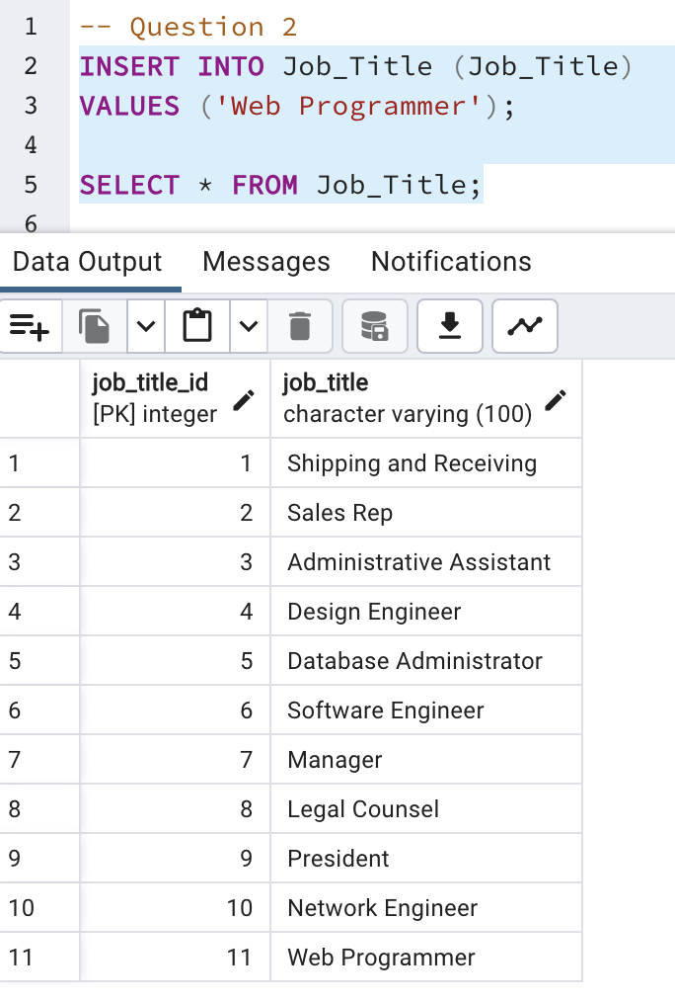
CRUD
Question 2: Insert Web Programmer as a new job title

Slide 26
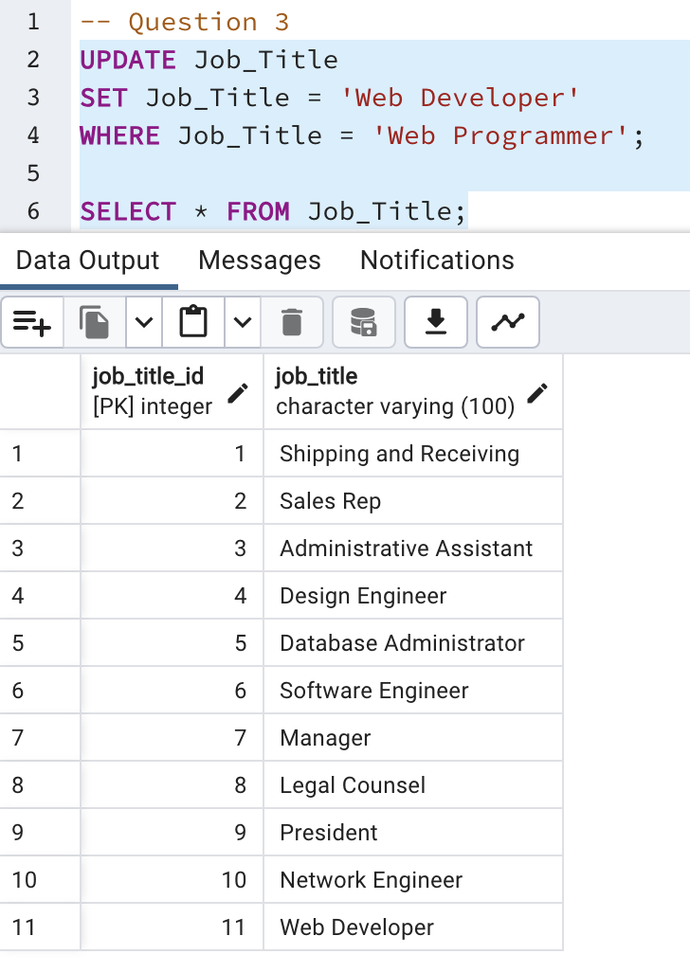
CRUD
Question 3: Correct the job title from web programmer to web developer

Slide 27
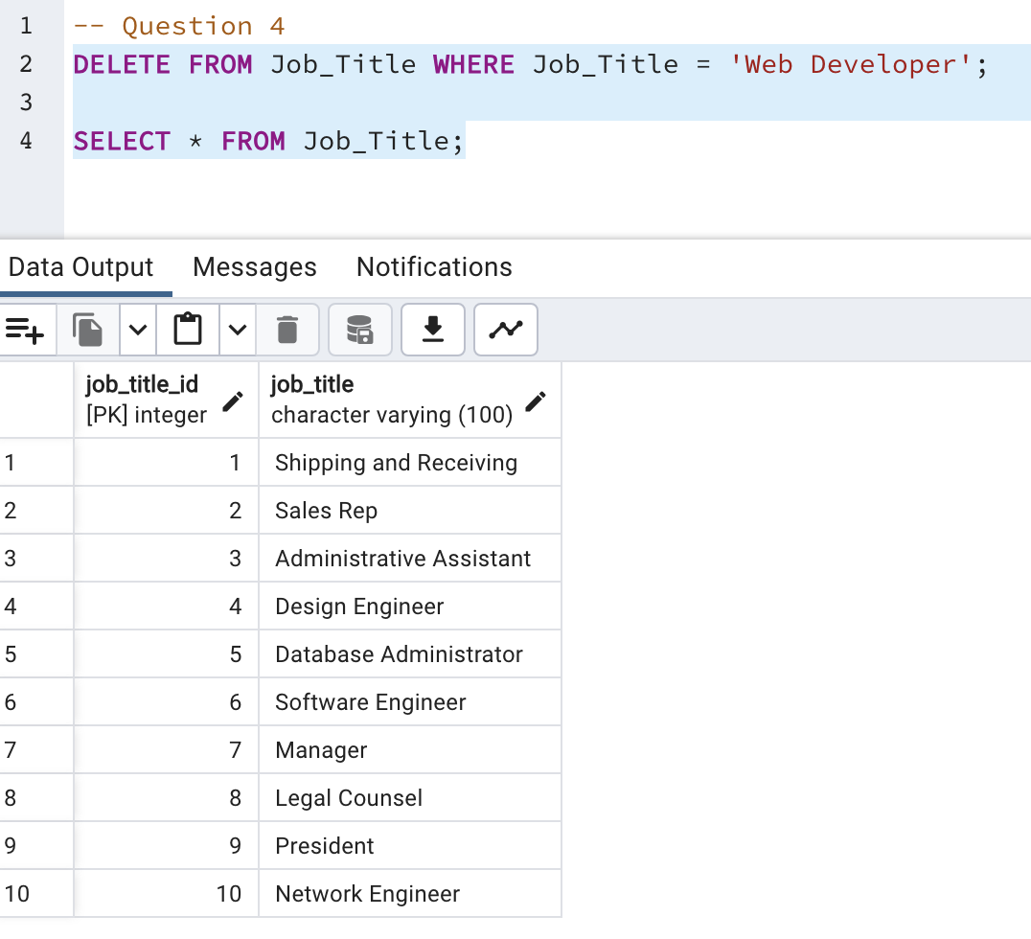
CRUD
Question 4: Delete the job title Web Developer from the database

Slide 28
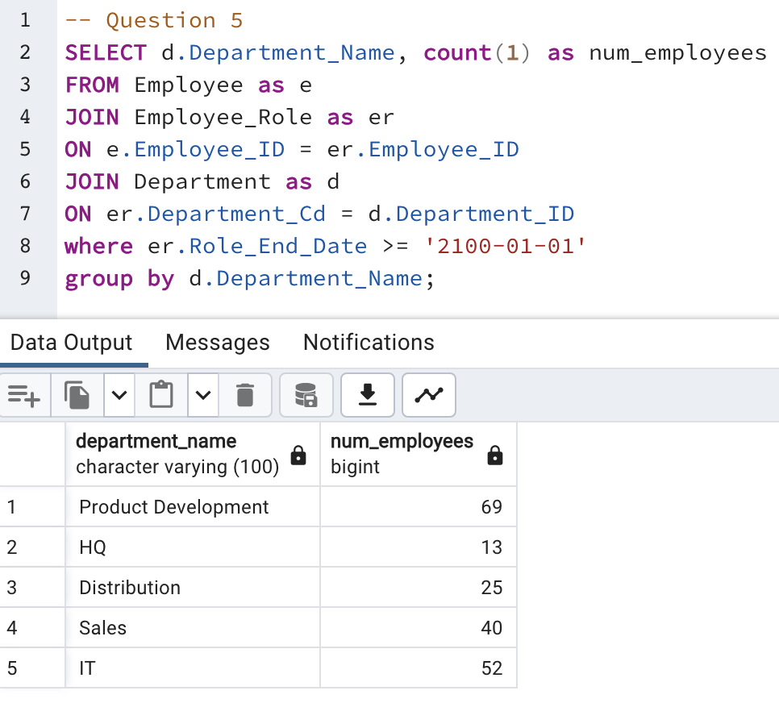
CRUD
Question 5: How many employees are in each department?

Slide 29
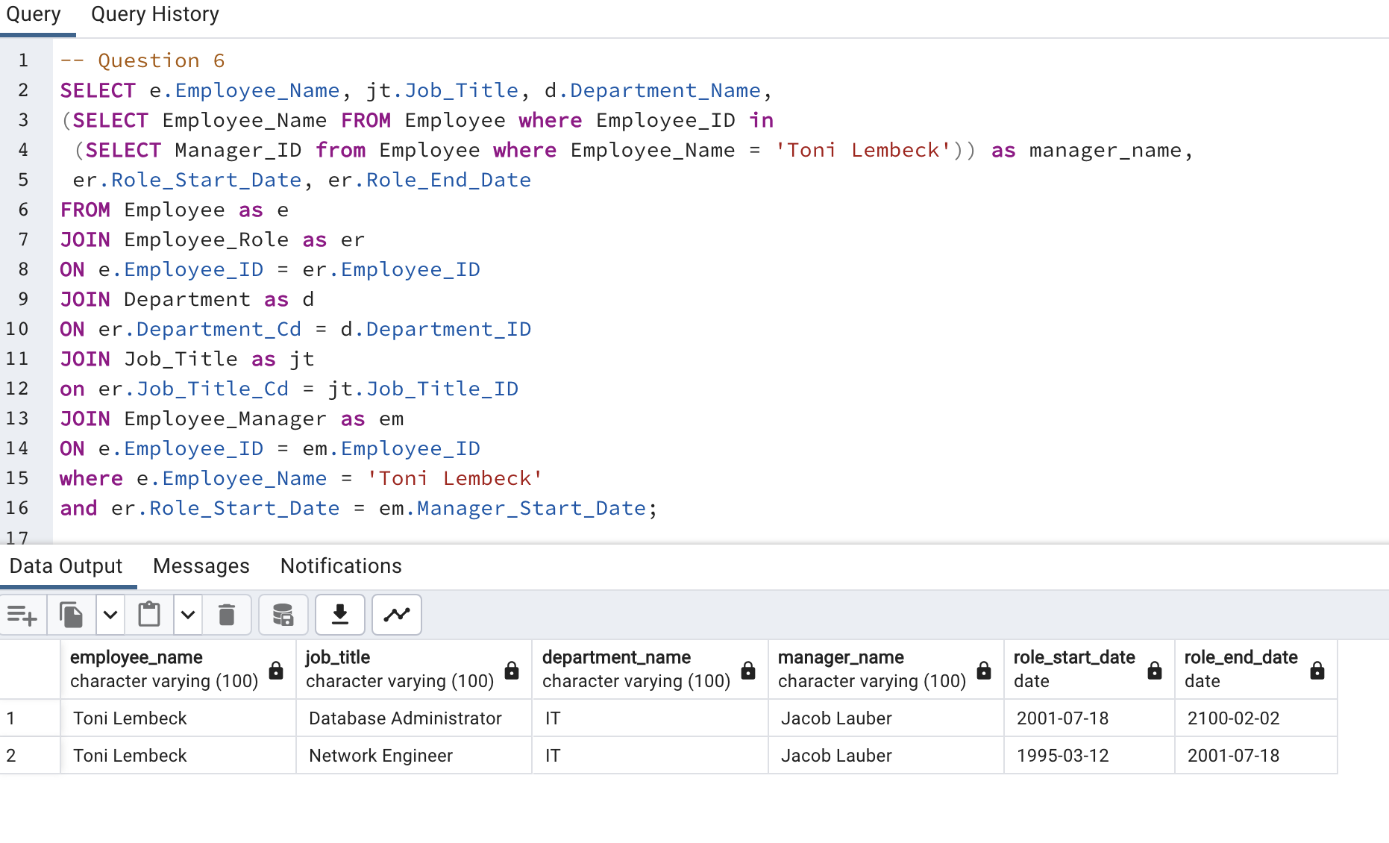
CRUD
Question 6: Write a query that returns current and past jobs (include employee name, job title, department, manager name, start and end date for position) for employee Toni Lembeck.

Slide 30
CRUD
Question 7: Describe how you would apply table security to restrict access to employee salaries using an SQL server.
First, I would start by defining at least two user roles: one for general users (employees with a domain login) and the other for HR and management users that have higher privileges (i.e. access to the Salary table.) I would then DENY access for the general ROLE to the Salary table and then GRANT access to the Salary table for the CRUD operations to privileged ROLE.

